Slide 1
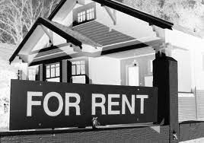

Inn the Neighborhood
PRICE ESTIMATION OF PROPERTY RENTALS
BY
Emmanuel Adetunji
(Data scientist)
Notes:
Good day to all my fellow data enthusiasts and potential clients. I am ________ from Neural Data Solutions. We are honoured to day to be presenting at the 7th Edition of DataCon Africa our Climate change believe analysis application ECO-TERRA.

Slide 2
PRESENTATION OUTLINE
INTRODUCTION
SOLUTION
MODELLING
1
3
5
2
4
6
PROBLEM STATEMENT
DATA INSIGHTS
CONCLUSION AND RECOMMENDATIONS
Notes:
A brief outline of our presentations is as follows…….Introduction…..

Slide 3

PROBLEM STATEMENT
Motivator
Inn the Neighborhood company realize there is low conversion rate on there web page
The company want to look for ways to motivate potential client
I was task with creating an application that could foretell potential rentals price
Notes:
On this note, Many companies are committed to a sustainable future and to improving the social, economic and environmental well being of the community and are built around lessening one’s environmental impact or carbon footprint. They offer products and services that are environmentally friendly and sustainable, in line with their values and ideals. To assist these companies with their market research efforts in gauging how their product/service may be received. We at Neural Data Solutions (NDS), were tasked with creating an application that is able to classify whether or not a person believes in climate change, based on their novel tweet data.

Slide 4
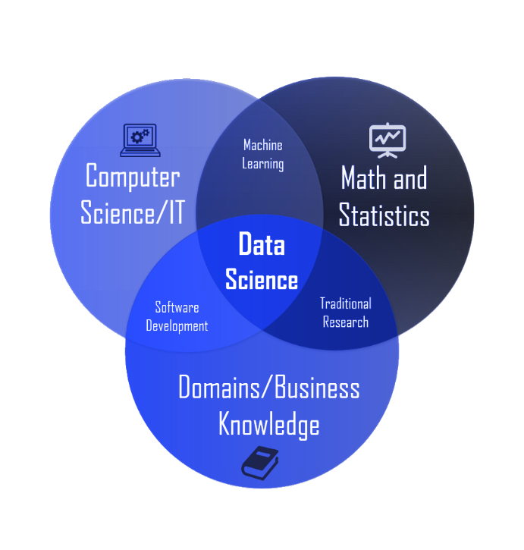

SOLUTION
Historical data
(property rented)
Data Science
Customer Motivation to rent-out
Notes:
Data science is an interdisciplinary field that uses scientific methods, processes, algorithms and systems to extract knowledge and insights from noisy, structured and unstructured data

Slide 5
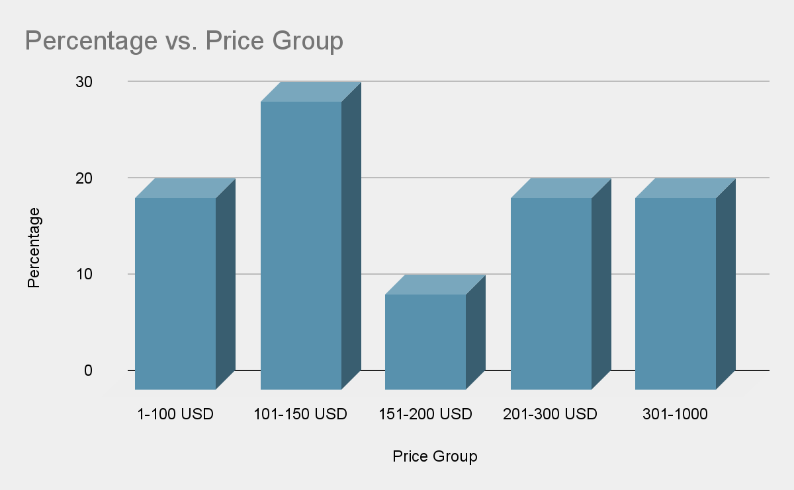
DATASET OVERVIEW
Price Distribution

Slide 6
Feature Importance
Bathroom
Dome, resort and Town house have more Bathrooms
Bedrooms
Bed and Breakfast, Hostel, Apart have more Bedrooms
Minimum Night
This seems not to have much weight on price or have relationship on other features
Latitude
Provide less information
Provide lesser information
Longitude
Not relevant to analysis
ID

Slide 7
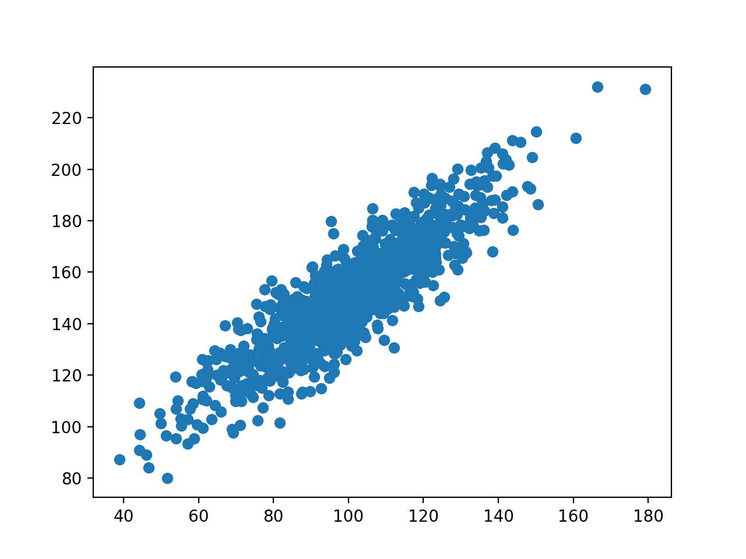
Feature Influencing Price
Correlation
Price
Bathroom
Bedroom

Slide 8
MACHINE LEARNING PROCESS
Stage 1
Stage 2
Stage 3
Stage 5
Data Pre-processing
Features Engineering
Modeling
Model Performance
We clean the dataset, transform and look at insight the data offers
Selecting suitable predictor(s), engineering new features and preparing them for machine learning process
Understanding data entries pattern and using that to forecast future target variables
Selecting the best or most suitable model using various metrics to understand each model performance

Slide 9
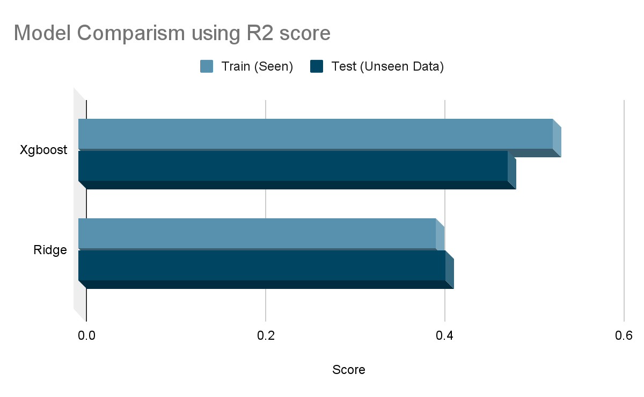
4000
3000
2000
1000
0
Both Model work well, with an accuracy of 73% going by the guide estimate Instruction

Slide 10

CONCLUSION & RECOMMENDATION
Based on the insights from the data:
The Model can do with more good features like “Bathrooms and Bedrooms
The solution we provide can give insight and predict the estimated price of property rentals
I would recommend that price of property can be regularized and new data can well inform future project
Screenshot of the app will go here

Slide 11
THANKS!
Any questions?

